Slide 1
Calories Burnt Prediction
Team Members
Simran-2210992382
Simrit-2210992384
Srishti-2210992404

Slide 2
Content
Problem Statement
Objective
Tools Used
Data Summary
Exploratory Data Analysis
Conclusion

Slide 3
Problem Statements
In this Calories Burnt Prediction, we are analyzing the relationship between individual health metrics, including calorie intake, gender, age, height, weight, activity duration, heart rate, and body temperature.
Identify patterns, correlations, and factors influencing overall health and wellness. Develop insights to predict the calories burnt prediction.
The purpose of this capstone project is to address the above problem by doing a comprehensive and effective analysis of Calories burnt prediction. This project aims to provide a detailed understanding of the patterns of different factors.

Slide 4
Objective
The objective of the project is to perform an Exploratory Data Analysis and to predict the calories burnt.
We have perform Data pre-processing, data cleaning and at the end, Data Wrangling and apply different Data Visualization Techniques, Feature Engineering( Categorical Encoding, Separating features and Targets, Data Splitting), ML Model Implementation.
This project aims to apply some Python libraries which will help to visualise and understand the data more easily and then to predict the calories Burnt.
We have apply the Machine Learning to predict the calories burnt prediction using linear regression, Decision tree, Random Forest Regression.

Slide 5
Tools Used
Google Collab
Pandas and NumPy are used for Data Manipulation & Pre-processing and Mathematical functions respectively.
Exploratory data analysis is automated by data prep.
For visualization of the plots, Matplotlib, Seaborn, Plotly are used.
For Data Preprocessing, we are using Categorical Encoding, Separating Features and Target Data Splitting.
For Machine Learning Model Implementation, we have use Three models(Linear Regression, Decision Tree, Random Forest Regression

Slide 6
Data Summary
Numerical Data
User Id
Age
Height
Weight
Duration
Body Temp
Heart Rate
Calories
Categorical Data
Gender

Slide 7
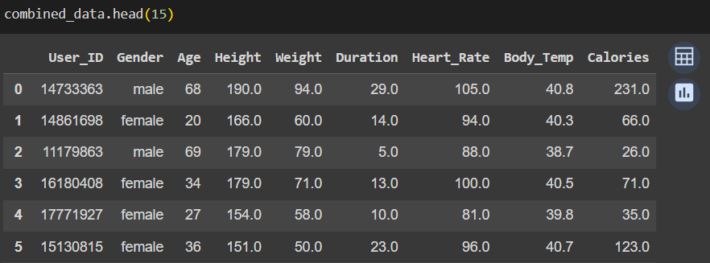
Data Summary
This is the Data of Calories Burnt Prediction Dataset.

Slide 8
Features Description
User_id: This is the user id given to each person.
Gender: This is the categorical data that helps to categories data between males and females
Age: It tell about the person’s age.
Height: It tell about the person’s Height in cm.
Weight: It tell about the person’s Weight in kg.
Duration: It tell about the person’s activity session period.
Body_Temp: It tell about the person’s Body temperature in celsius.
Heart_Beat: It tell about the person’s Heart beating per second.
Calories: It tell about the person’s Calories consumption.

Slide 9
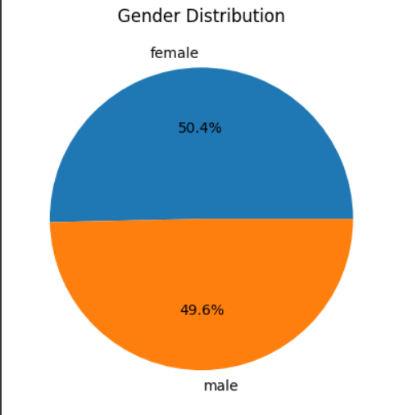
Pie Chart and Bar Plot
A pie chart is a circular statistical graphic that is divided into slices to illustrate numerical proportions.
This Pie chart aims to show the distribution of the gender.
This data shows that the percentage of females is more than males in data.

Slide 10
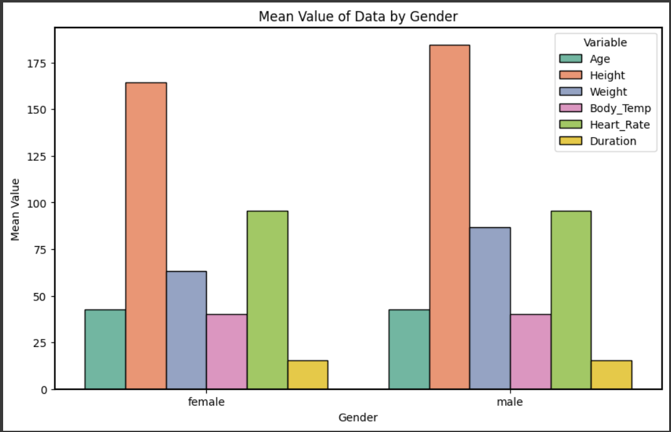
Bar Plot
Bar plots are excellent for comparing the counts or frequencies of different categories.
In this graph we are comparing the mean values of different variables for males and females separately.
The chart likely aims to compare the mean value of number of Variables associated with Gender.

Slide 11
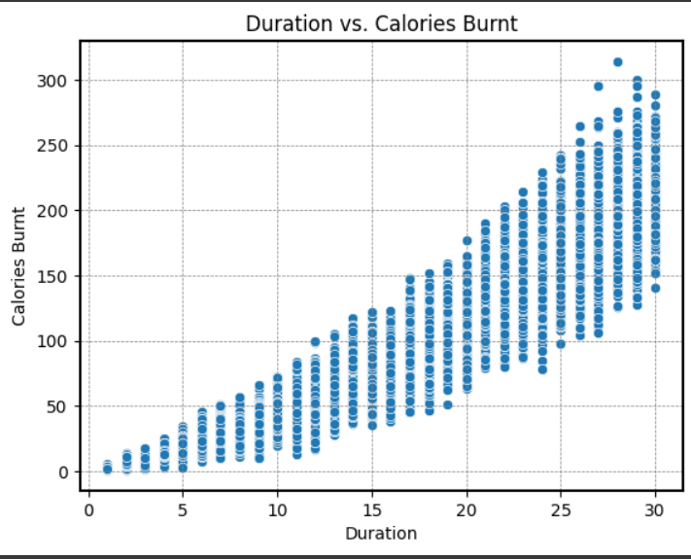
Scatter Plot
A scatter plot is a type of mathematical diagram using Cartesian coordinates to display values for typically two variables for a set of data.
This is the scatter plot which is showing the data between Duration Vs Calories.
This Scatter plot is showing that with increase in the duration the calories burn also increases.

Slide 12
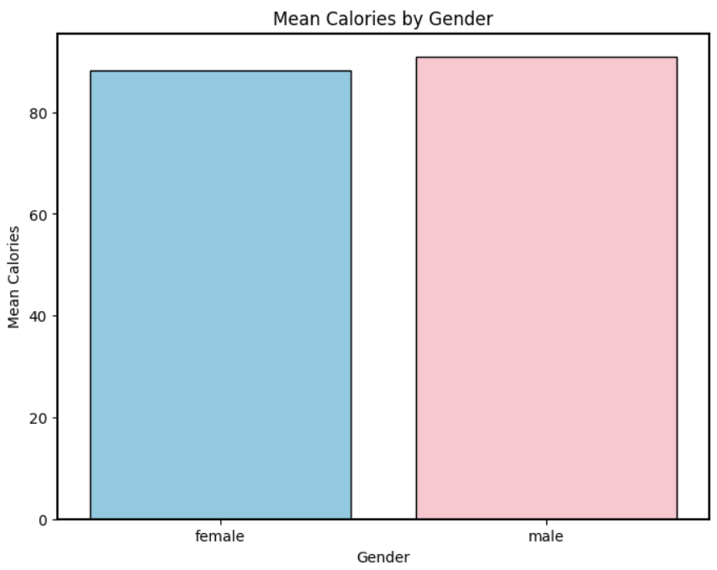
Bar Plot
A bar plot, also known as a bar chart, is a graphical representation of categorical data with rectangular bars. Each bar represents a category or group, and the length or height of the bar corresponds to the frequency, count, or proportion of data points in that category.
This aims to show the distribution of the gender in terms of mean calories.

Slide 13
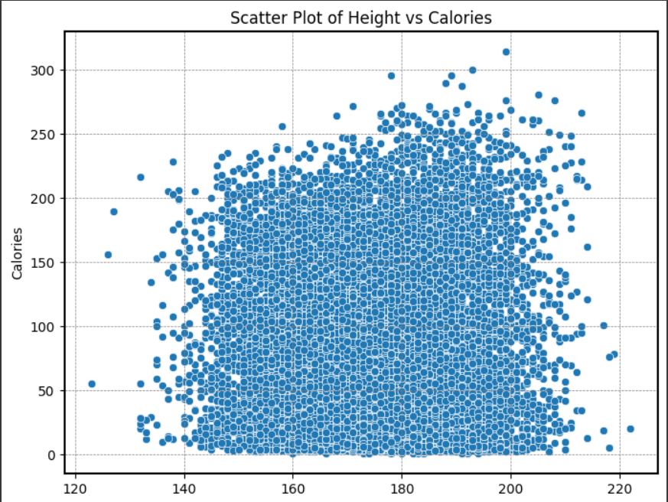
Scatter Plot
A scatter plot is a type of mathematical diagram using Cartesian coordinates to display values for typically two variables for a set of data.
This plot shows between Height Vs Calories.

Slide 14
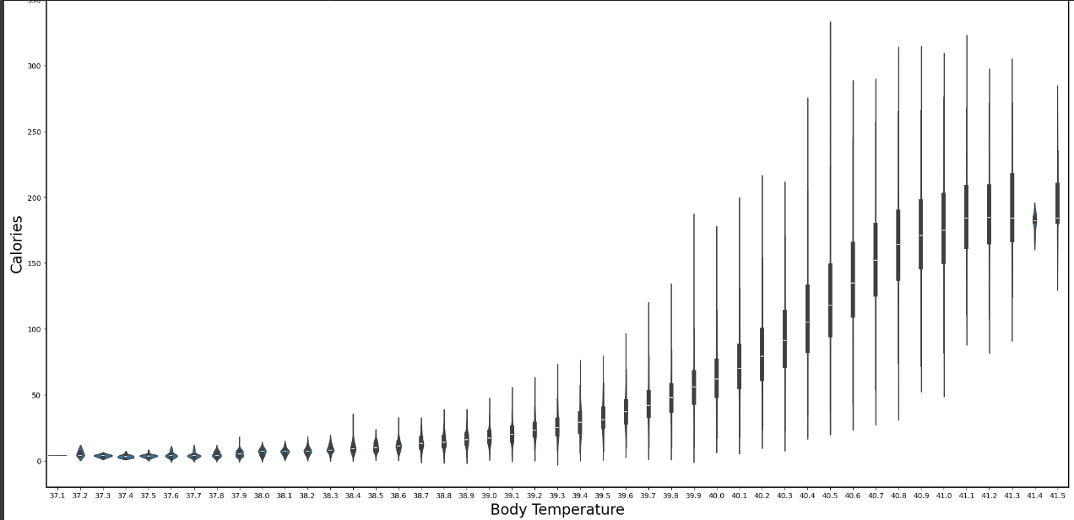
Violin Plot
A violin plot is a method of plotting numeric data and is a combination of a box plot and a kernel density plot. It displays the distribution of the data, providing insights into its probability density.
The plot is between Body Temperature Vs calories.

Slide 15
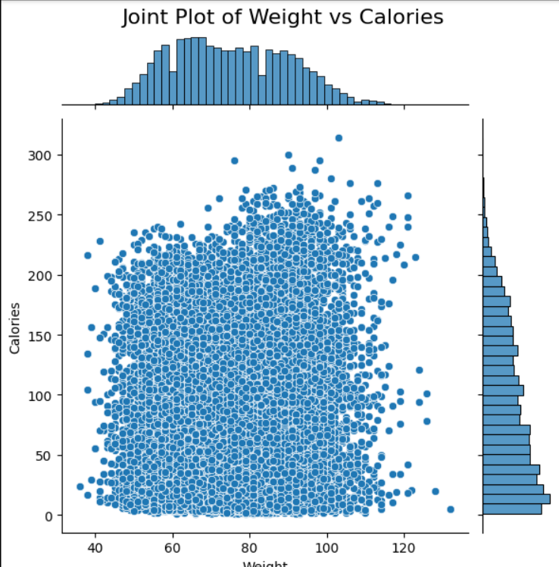
Joint Plot Between Weight and Calories
A joint plot is a type of data visualization that combines multiple plots to display the relationship between two variables, usually a bivariate relationship. It typically consists of a central scatter plot or other bivariate plot, accompanied by additional marginal plots that show the distribution of each variable separately.
.
This plot is between Weight Vs Calories.

Slide 16
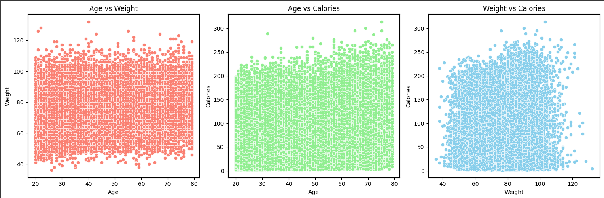
Multiple Scatter Plot
The specific chart, which consists of three scatter plots showing the relationships between 'Age', 'Weight', and 'Calories', was chosen because it allows for a visual examination of how these variables interact with each other
This plot shows between Age Vs Calories, Age Vs Weight, Weight Vs Calories.

Slide 17
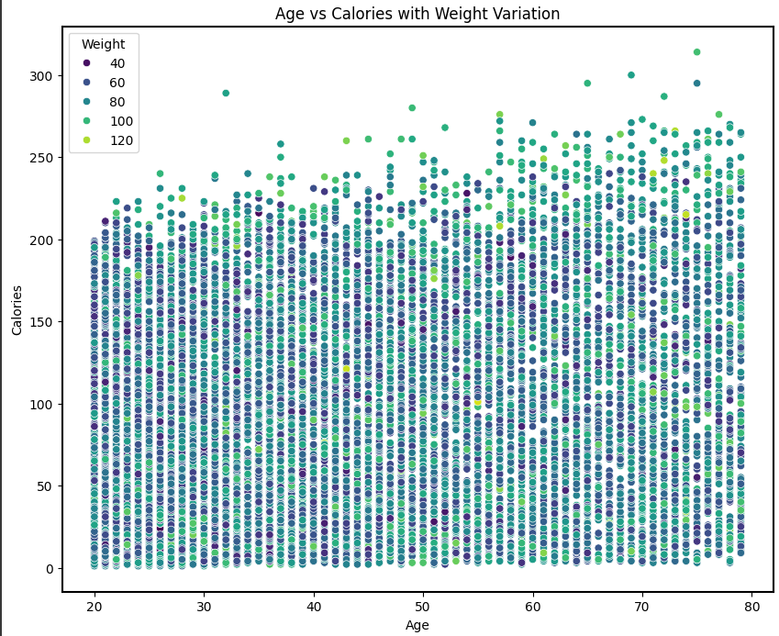
Scatter Plot
A scatter plot is a type of mathematical diagram using Cartesian coordinates to display values for typically two variables for a set of data.
This plot shows between Age Vs Calories with Weight Variation

Slide 18
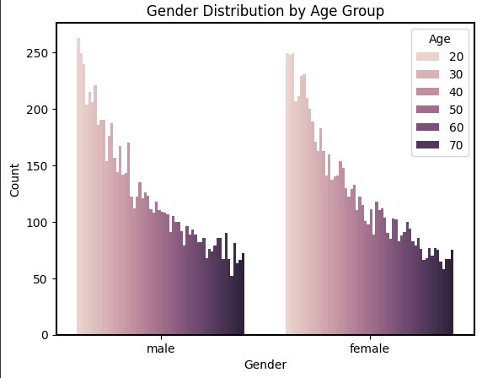
Count Plot
The chosen chart is a count plot, which is suitable for visualizing the distribution of categorical variables, in this case, 'Gender' and 'Age Group'. The use of hue separates the bars by age group within each gender category.
This plot shows between Gender Distribution by Age Group.

Slide 19
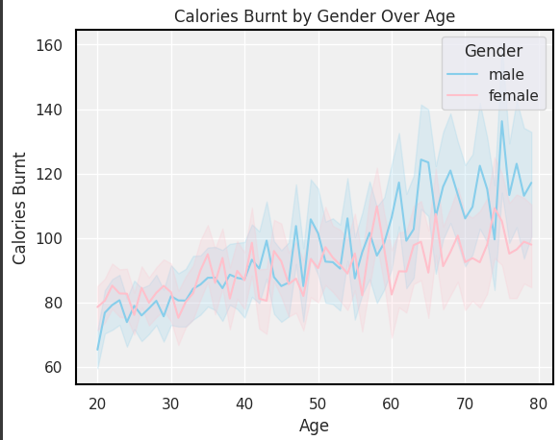
Line Plot
Line plots are particularly useful for displaying trends and patterns over continuous variables(in this case, the age from 20 to 80). By using different colors for Gender, this allows for easy comparison between gender and identification of any significant shifts or patterns in the data.
Males has sharp increase in Calories Burnt in age between 70 to 80. Similarly females has sharp increase in Calories burnt in age 55 to 60.

Slide 20
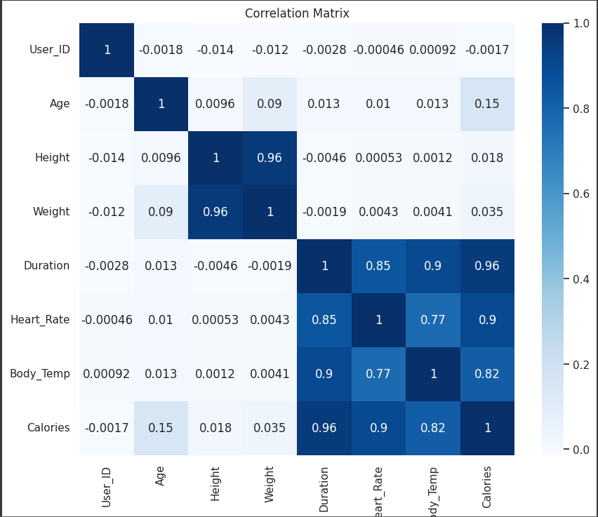
Heatmaps Visualisation
Heatmaps are effective for displaying the correlation matrix, as they provide a clear visual representation of the strength and direction of relationships between variables. The colors used in the heatmap help users quickly identify areas of high correlation (positive or negative) and low correlation.
Height and Duration , Weight and Duration have a negative correlation.

Slide 21
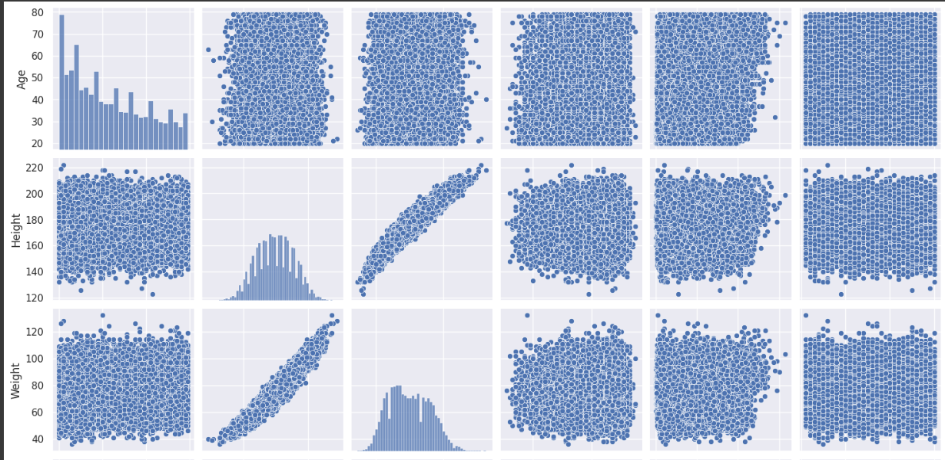
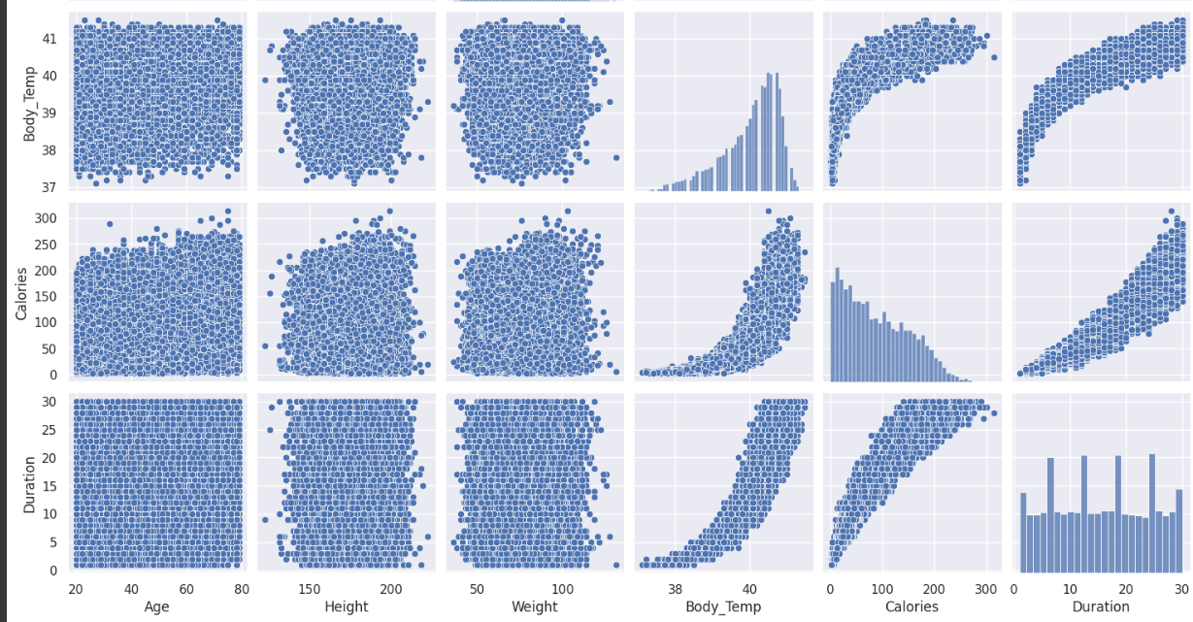
Pair Plot
Pair plots allow us to visualize relationships between every pair of variables in the dataset. This comprehensive view is valuable for understanding how variables relate to each other and identifying potential patterns or trends.
The scatter plots in the pair plot can reveal patterns of correlation between pairs of variables. Positive correlations are indicated by a general upward trend in the scatter plot, while negative correlations are indicated by a downward trend.

Slide 22
Conclusions
Linear Regression
Linear regression is a linear approach to modeling the relationship between a dependent variable and one or more independent variables
Prediction:
r2 score: 0.9658686545701699
MAE: 8.478768136376313
MSE: 136.87396223386153
RMSE: 11.699314605303233
Decision Tree
Decision Trees are non-parametric supervised learning models used for classification and regression tasks.
Prediction:
R2 score: 0.9924975720804919
MAE: 3.4936666666666665
MSE: 30.086333333333332
RMSE: 5.48510103219014

Slide 23
Conclusion
Random Forest Regressor
Random Forest is an ensemble learning method that combines multiple decision trees to create a more robust and accurate model
Prediction:
r2 score: 0.9978126574273661
MAE: 1.8108033333333333
MSE: 8.7717094333333331
RMSE: 2.961707182240225
Support vector machine
SVM is used to find the optimal hyperplane in an N-dimensional space that can separate the data points in different classes in the feature space.
Prediction:
r2 score: 0.9615371412685408
MAE: 8.392661700174376
MSE: 154.2442528156233
RMSE: 12.41951097328809

